Slide 1

MyFM Project
Project Members
Advisor
Necati Anıl Gökkaya - 201511025
Orkun Güneri - 201611025
Erenalp Kesici - 201811406
Prof. Dr. Hasan OĞUL

Slide 2
Contents
Project Features
Analysis of The Already Existing Apps
Application Introduction
Development Tools
Problems

Slide 3
Application Introduction
MyFm is a music recommendation app that records the songs users listen to daily and recommends new songs, albums or bands to them. It also allows you to record your songs and listen to them later. In the app you can access lyrics or check other users' profile.

Slide 4
Problems
Most listened genre
No lyrics
Last song we listened
Most listened songs

Slide 5
My-FM Features
Listening to Music Offline/Online
Creating Music Playlist
User Profile
Music Lyrics
Recommendation

Slide 6
Development Tools
Android Studio
Flutter
Dart

Slide 7
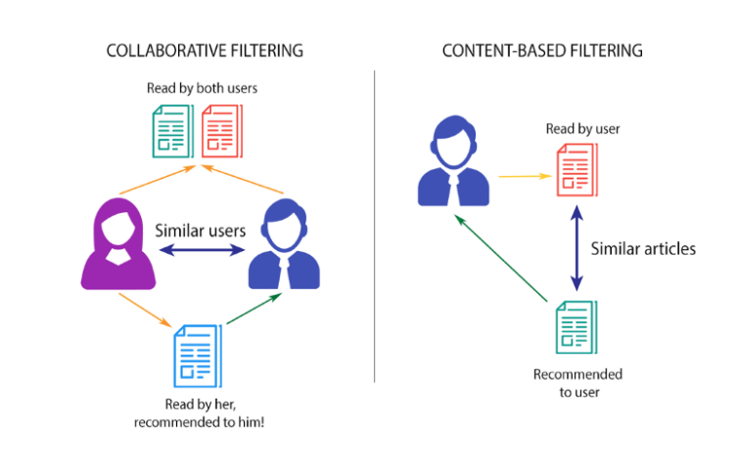
How the recommendation system works?
Get user preference
Finding songs based on user’s interest
Makes recommendation based on previous songs

Slide 8
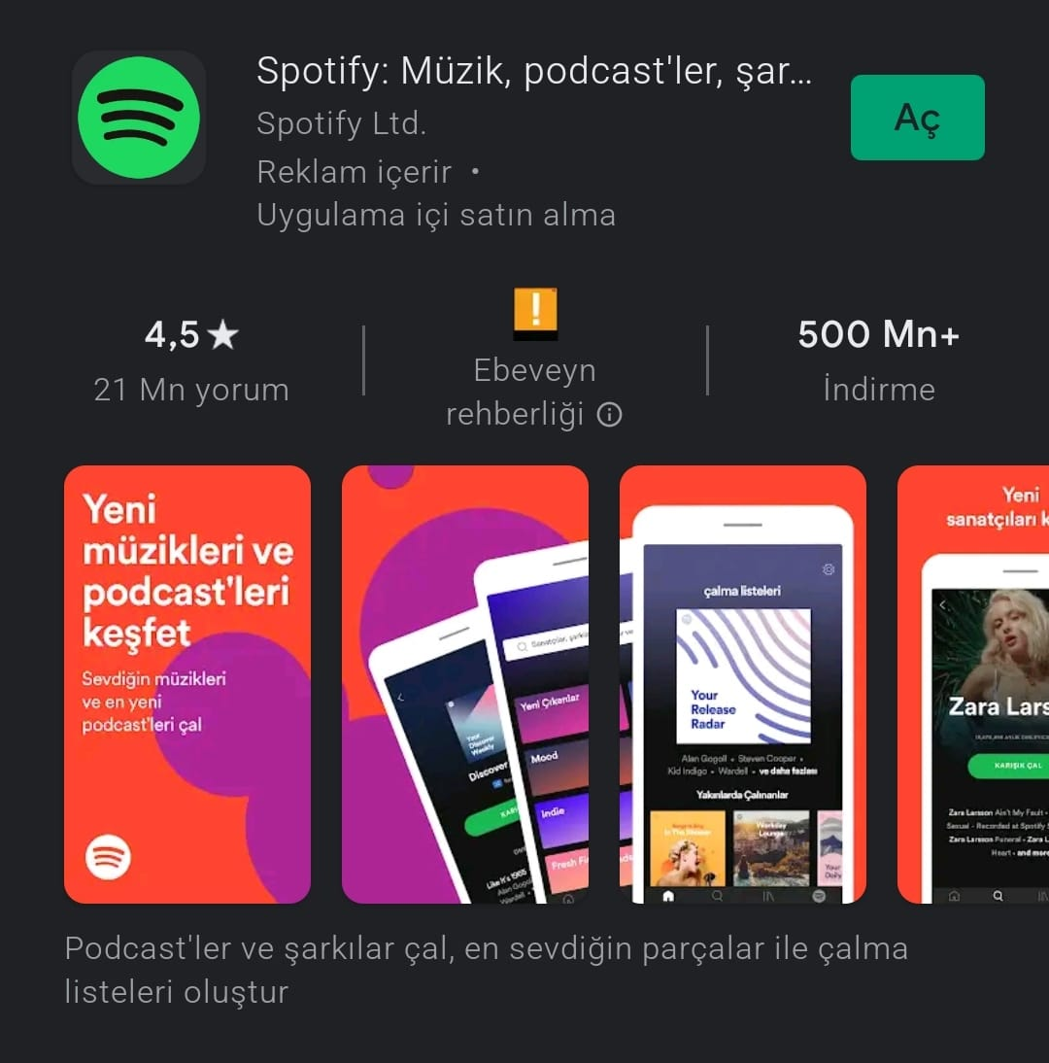
Analysis of The Already Existing Apps
Spotify is an online music streaming application that has reached more than 500 million downloads.
It has similar functionalities in that it lets users listen to music, provides the user with personalized recommendations and so on.

Slide 9

Analysis of The Already Existing Apps
Another popular, similar application is YouTube Music.
It is a music streaming service developed by Google. It provides a simple user interface for music streaming.
It also allows for users to be able to browse through songs and music videos on YouTube based on genres, playlists, and recommendations.

Slide 10

Analysis of The Already Existing Apps
Another popular, similar application is Apple Music.
It is a music and video streaming service developed by Apple Inc.
Users select music to stream to their device on-demand, or they can listen to existing playlists.
Apple Music can also provide the user with personalized playlists.

Slide 11
Feature | My-FM | Spotify | Youtube Music
Personalized Profile | + | + | -
Showing Last Listened | + | - | +
Playlist | + | + | +
Music Lyrics | + | - | +
Which music their friends are listening to | + | + | -
Most listened songs | + | + | -
Weekly and Daily recommendation | + | + | -
Listening to Music Offline/Online | + | + | +

Slide 12
Thank You For Listening

